Slide 1
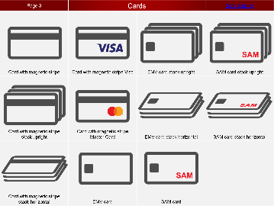
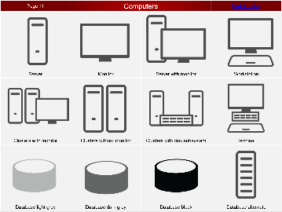
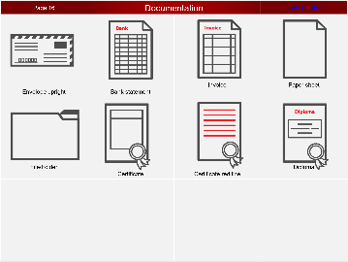
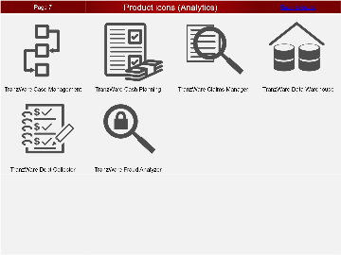
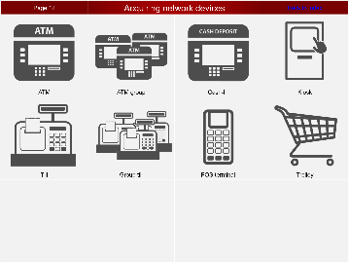
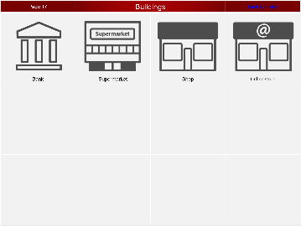
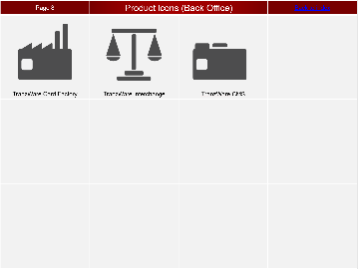
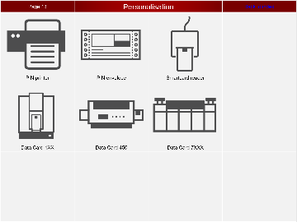
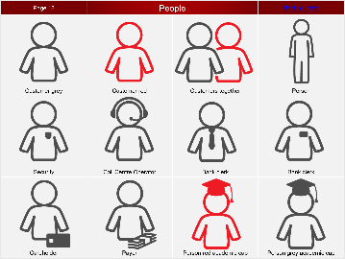
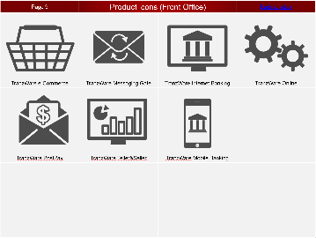
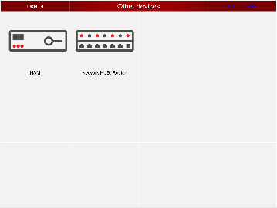
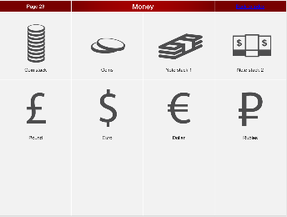
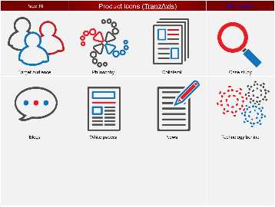
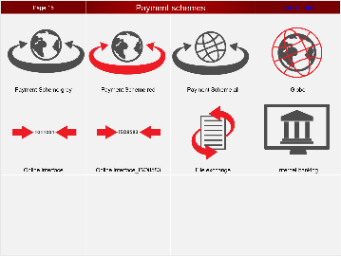
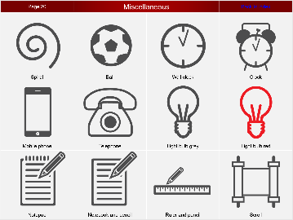
Index |  |  |  |  | version - 3.01
 | Cards Page 3 |  | Computers Page 8 |  | Documentation Page 13
 | Product icons (Analytics) Page 4 |  | Acquiring network devices Page 9 |  | Buildings Page 14
 | Product icons (Back Office) Page 5 |  | Personalisation Page 10 |  | People Page 15
 | Product icons (Front Office) Page 6 |  | Computers Page 11 |  | Money Page 16
 | Product icons (TranzAxis) Page 7 |  | Payment schemes Page 12 |  | Miscellaneous Page 17

Slide 2
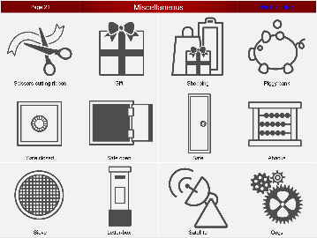
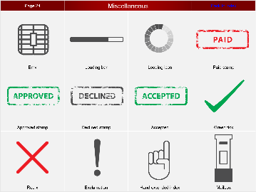
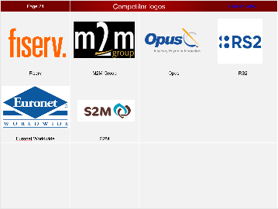
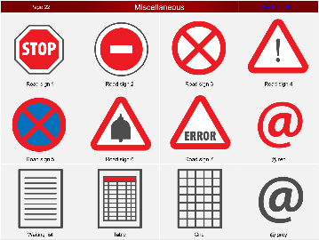
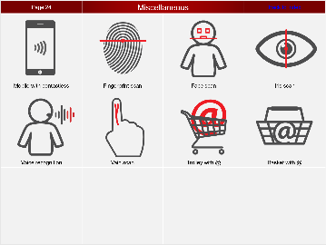
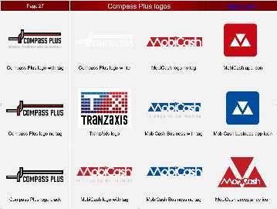
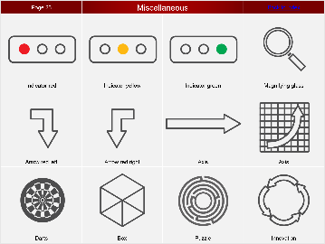
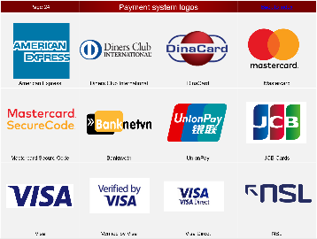
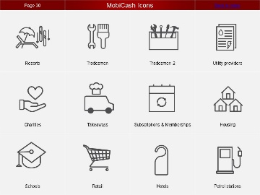
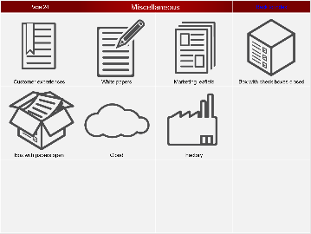
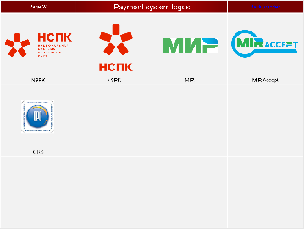
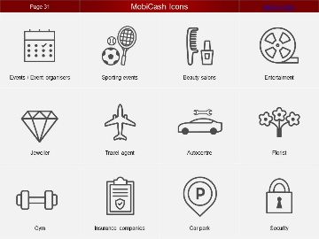
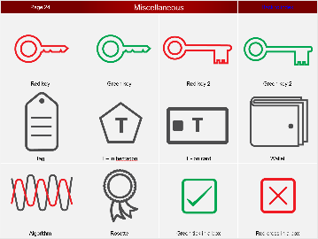
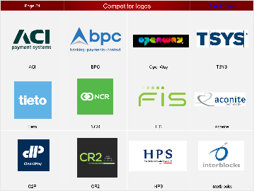
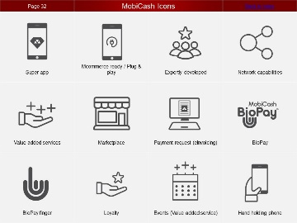
Index |  |  |  |  | version - 3.01
 | Miscellaneous Page 18 |  | Miscellaneous Page 23 |  | Competitor logos Page 28
 | Miscellaneous Page 19 |  | Miscellaneous Page 24 |  | Compass Plus logos Page 29
 | Miscellaneous Page 20 |  | Payment system logos Page 25 |  | MobiCash icons Page 30
 | Miscellaneous Page 21 |  | Payment system logos Page 26 |  | MobiCash icons Page 31
 | Miscellaneous Page 22 |  | Competitor logos Page 27 |  | MobiCash icons Page 32

Slide 3
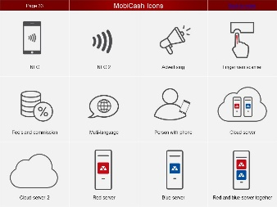
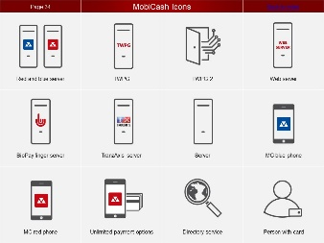
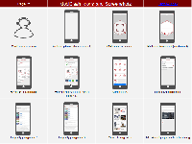
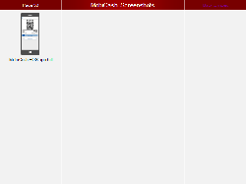
Index |  |  |  |  | version - 3.01
 | MobiCash icons Page 34
 | MobiCash icons Page 35
 | MobiCash icons and Screenshots Page 36
 | MobiCash Screenshots Page 37

Slide 4





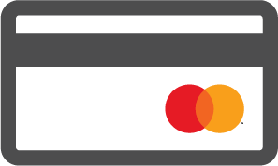





Page 3 | Cards |  | Back to index
Card with magnetic stripe | Card with magnetic stripe Visa | EMV card stack upright | SAM card stack upright
Card with magnetic stripe stack upright | Card with magnetic stripe Master Card | EMV card stack horizontal | SAM card stack horizontal
Card with magnetic stripe stack horizontal | EMV card | SAM card

Slide 5






Page 4 | Product icons (Analytics) |  | Back to index
TranzWare Case Management | TranzWare Cash Planning | TranzWare Claims Manager | TranzWare Data Warehouse
TranzWare Debt Collector | TranzWare Fraud Analyzer

Slide 6



Page 5 | Product icons (Back Office) |  | Back to index
TranzWare Card Factory | TranzWare Interchange | TranzWare CMS

Slide 7







Page 6 | Product icons (Front Office) |  | Back to index
TranzWare e-Commerce | TranzWare Messaging Gate | TranzWare Internet Banking | TranzWare Online
TranzWare PostPay | TranzWare Teller&Seller | TranzWare Mobile Banking

Slide 8








Page 7 | Product icons (TranzAxis) |  | Back to index
Target audience | Philosophy | Collateral | Case study
Blogs | White papers | News | Technology behind

Slide 9












Page 8 | Computers |  | Back to index
Server | Monitor | Server with monitor | Workstation
Clusters with monitor | Clusters without monitor | Clusters with disk subsystem | Terminal
Database light grey | Database dark grey | Database black | Database alternate

Slide 10



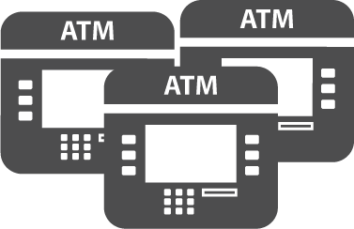
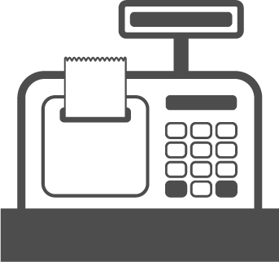



Page 9 | Acquiring network devices |  | Back to index
ATM | ATM group | Cash-In | Kiosk
Till | Group till | POS terminal | Trolley

Slide 11






Page 10 | Personalisation |  | Back to index
PIN printer | PIN envelope | Smartcard reader
Data Card 1XX | Data Card 450 | Data Card 7XXX

Slide 12


Page 11 | Other devices |  | Back to index
HSM | Network HUB, Router

Slide 13








Page 12 | Payment schemes |  | Back to index
Payment Scheme grey | Payment Scheme red | Payment Scheme all | Globe
Online interface | Online interface_ISO8583 | File exchange | Internet banking

Slide 14








Page 13 | Documentation |  | Back to index
Envelope upright | Bank statement | Invoice | Paper sheet
File/Folder | Certificate | Certificate red line | Diploma

Slide 15




Page 14 | Buildings |  | Back to index
Bank | Supermarket | Shop | Online store

Slide 16












Page 15 | People |  | Back to index
Customer grey | Customer red | Customers together | Person
Security | Call Centre Operator | Bank clerk | Bank clerk
Cardholder | Payer | Person red academic cap | Person grey academic cap

Slide 17








Page 16 | Money |  | Back to index
Coin stack | Coins | Note stack 1 | Note stack 2
Pound | Euro | Dollar | Rubles

Slide 18












Page 17 | Miscellaneous |  | Back to index
Spiral | Ball | Wall clock | Clock
Mobile phone | Telephone | Light bulb grey | Light bulb red
Notepad | Notebook and pencil | Ruler and pencil | Scroll

Slide 19












Page 18 | Miscellaneous |  | Back to index
Scissors cutting ribbon | Gift | Shopping | Piggy bank
Safe closed | Safe open | Safe | Abacus
Sieve | Letter-box | Satellite | Cogs

Slide 20












Page 19 | Miscellaneous |  | Back to index
Road sign 1 | Road sign 2 | Road sign 3 | Road sign 4
Road sign 5 | Road sign 6 | Road sign 7 | @ red
Waiting list | Table | Grid | @ grey

Slide 21












Page 20 | Miscellaneous |  | Back to index
Indicator red | Indicator yellow | Indicator green | Magnifying glass
Arrow red left | Arrow red right | Axis | Axis
Darts | Box | Puzzle | Innovation

Slide 22







Page 21 | Miscellaneous |  | Back to index
Customer experiences | White papers | Marketing leaflets | Box with check boxes closed
Box with papers open | Cloud | Factory

Slide 23












Page 22 | Miscellaneous |  | Back to index
Red key | Green key | Red key 2 | Green key 2
Tag | T – in hectagon | T - on card | Wallet
Algorithm | Rosette | Green tick in a box | Red cross in a box

Slide 24












Page 23 | Miscellaneous |  | Back to index
Emv | Loading bar | Loading icon | Paid stamp
Approved stamp | Declined stamp | Accepted | Green tick
Red x | Exclamation | Hand extended index | Mailbox

Slide 25








Page 24 | Miscellaneous |  | Back to index
Mobile with contactless | Fingerprint scan | Face scan | Iris scan
Voice recognition | Vain scan | Trolley with @ | Basket with @

Slide 26










Page 25 | Payment system logos |  | Back to index
American Express | Diners Club International | DinaCard | Mastercard
Mastercard Secure Code | Banknvetn | UnionPay | JCB Cards
Visa | Verified by Visa | Visa Direct | NSL

Slide 27





Page 26 | Payment system logos |  | Back to index
NSPK | NSPK | MIR | MIR Accept
ORS

Slide 28












Page 27 | Competitor logos |  | Back to index
ACI | BPC | OpenWay | TSYS
Tieto | NCR | FIS | Aconite
C2P | CR2 | HPS | Interblocks

Slide 29






Page 28 | Competitor logos |  | Back to index
Fiserv | M2M Group | Opus | RS2
Euronet Worldwide | S2M

Slide 30












Page 29 | Compass Plus logos |  | Back to index
Compass Plus (Black and red) | Compass Plus logo white | MobiCash logo no tag | MobiCash app icon
Compass Plus logo no tag | TranzAxis logo | MobiCash Business with tag | MobiCash business app icon
Compass Plus logo black | MobiCash logo with tag | MobiCash Business no tag | MobiCash acceptance icon

Slide 31












Page 30 | MobiCash Icons |  | Back to index
Resorts | Tradesmen | Tradesmen 2 | Utility providers
Charities | Takeaways | Subscriptions & Memberships | Housing
Schools | Retail | Hotels | Petrol stations

Slide 32












Page 31 | MobiCash Icons |  | Back to index
Events / Event organisers | Sporting events | Beauty salons | Entertaiment
Jeweller | Travel agent | Autocentre | Florist
Gym | Insurance companies | Car park | Security

Slide 33












Page 32 | MobiCash Icons |  | Back to index
Super app | Mcommerce ready / Plug & play | Expertly developed | Network capabilities
Value added services | Marketplace | Payment request (eInvoicing) | BioPay
BioPay finger | Loyalty | Events (Value added service) | Hand holding phone

Slide 34












Page 33 | MobiCash Icons |  | Back to index
NFC | NFC 2 | Advertising | Finger vein scanner
Fee’s and commission | Multi-language | Person with phone | Cloud server
Cloud server 2 | Red server | Blue server | Red and blue server together

Slide 35
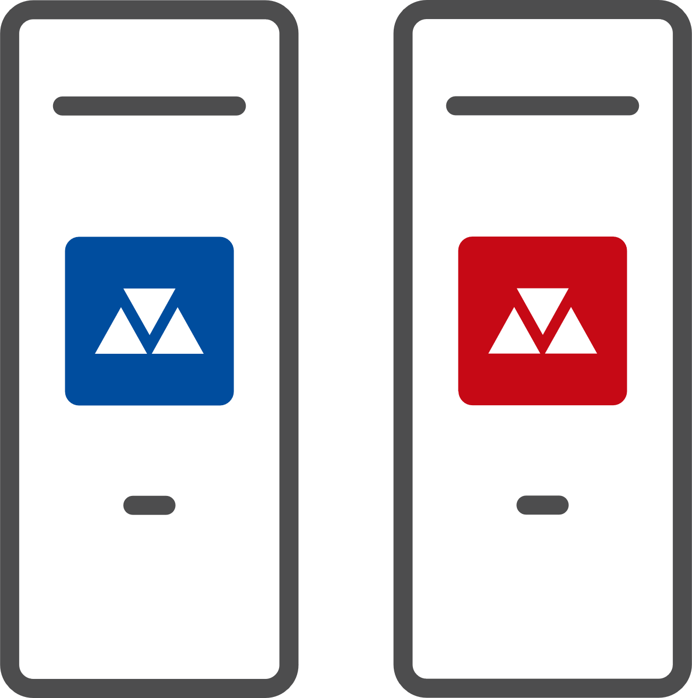




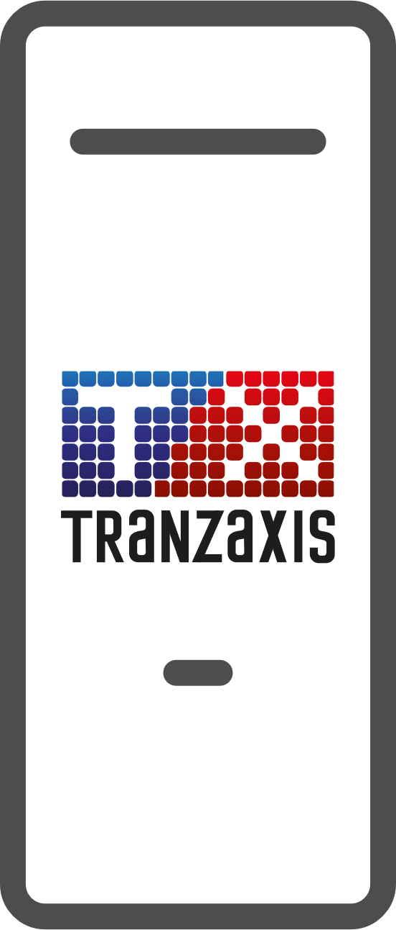



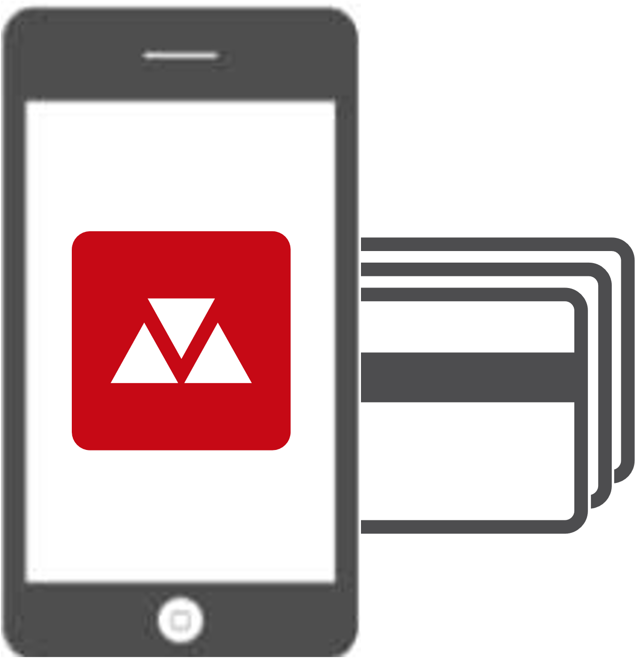


Page 34 | MobiCash Icons |  | Back to index
Red and blue server | TWPG | Payment gateway | Web server
BioPay finger server | TranzAxis server | Server | MC blue phone
MC red phone | Unlimited payment options | Directory service | Person with card

Slide 36

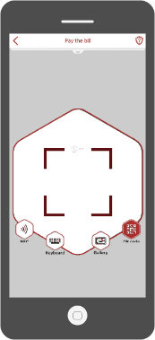
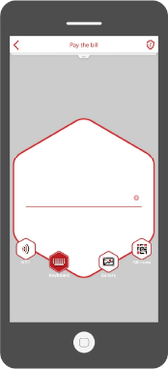

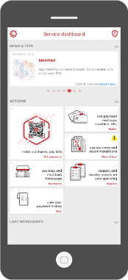
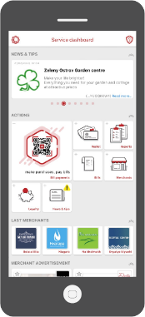
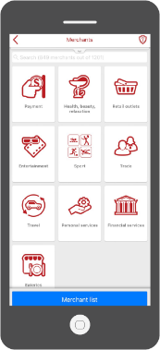

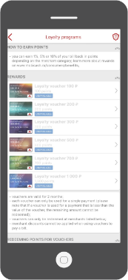
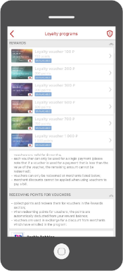
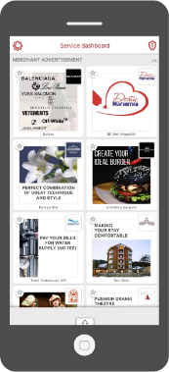
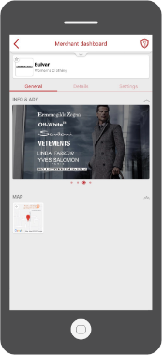
Page 35 | MobiCash Icons and Screenshots |  | Back to index
Customer service | Mobile phone (transparent) | QR code scanner | Bill number input (keyboard)
Service dashboard | Service dashboard with adverts | Merchants | Loyalty program 1
Loyalty program 2 | Loyalty program 3 | Advertising tiles | Merchant page with advertising

Slide 37
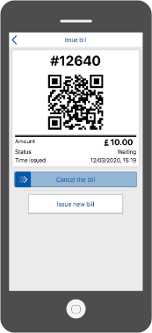
Page 36 | MobiCash Screenshots |  | Back to index
MobiCash POS app bill

